Slide 1
Methods I Lab Lecture 7

Slide 2
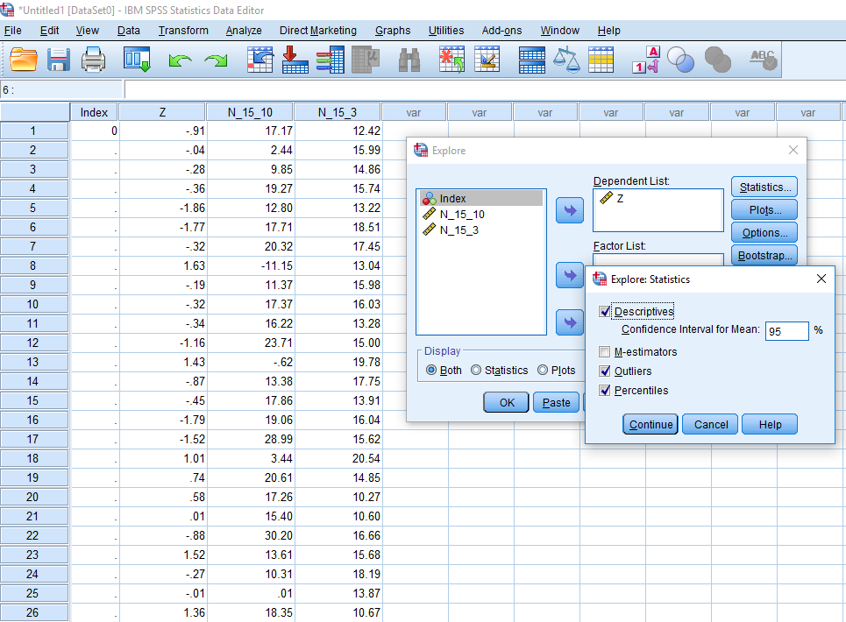
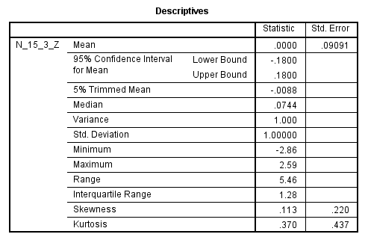
Normal Distribution - Recap
Find the Mean, Mean 95% CI, and the StdDev
Analyze
Descriptive Statistics
Explore…
Dependent = Variable
Statistics
Descriptives
Plots
Histogram

Slide 3
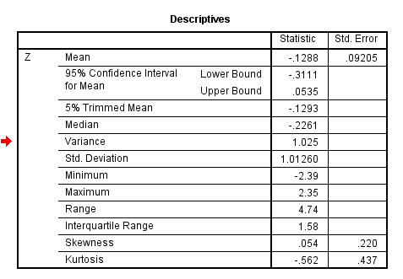
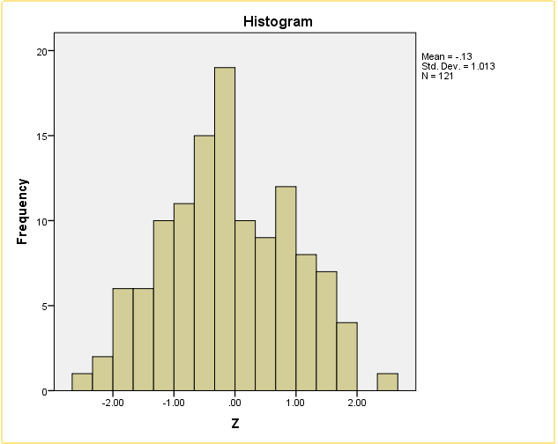
Normal Distribution - Recap
Verify that everything is as expected
What is the mean?
What is the standard deviation?
What is the standard error?
What is the confidence interval?
?

Slide 4
Onto fun stuff…

Slide 5
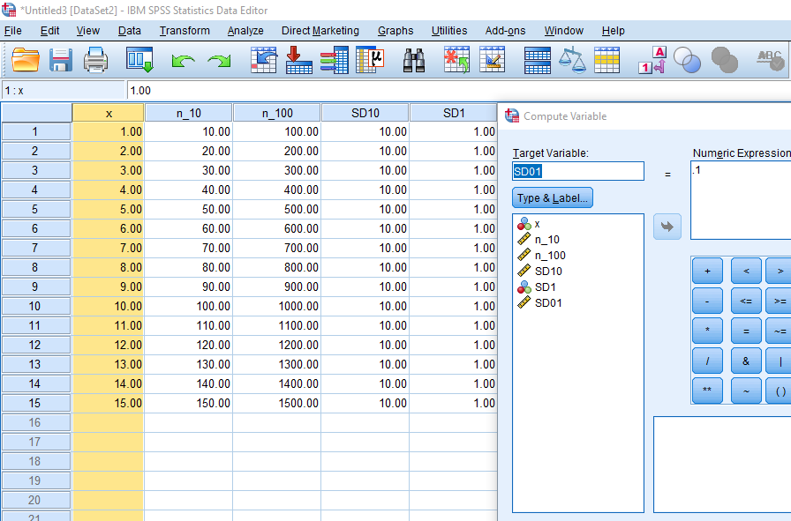
Mean standard error
Make a variable ‘x’ and type in the number 1 to 15 for the first 15 lines
Create 5 new variables as shown:
n_10 = x*10
n_100 = x*100
SD10 = 10
SD1 = 1
SD01 = .01

Slide 6
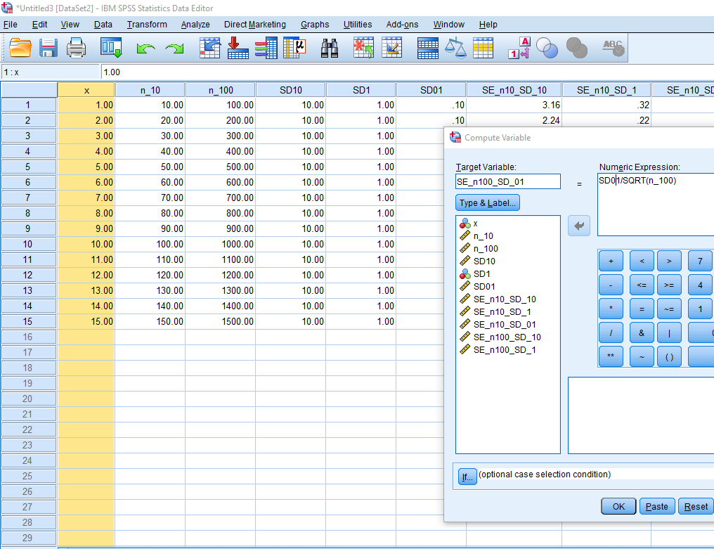
Mean standard error
Create 6 new variables as shown:
SE_n10_SD_10 = SD10/SQRT(n_10)
SE_n10_SD_1 = SD1/SQRT(n_10)
SE_n10_SD_01 = SD01/SQRT(n_10)
SE_n100_SD_10 = SD10/SQRT(n_100)
SE_n100_SD_1 = SD1/SQRT(n_100)
SE_n100_SD_01 = SD01/SQRT(n_100)

Slide 7
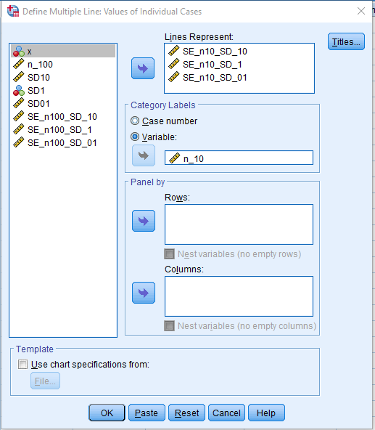
Mean standard error
Build a chart using the following instructions:
Graphs
Legacy Dialogue
Line…
Select: ‘Multiple’ and ‘Values of individual cases’
Lines Represent: All SE_n10 variables
and SD1 and SD01
Category Labels: n_10

Slide 8
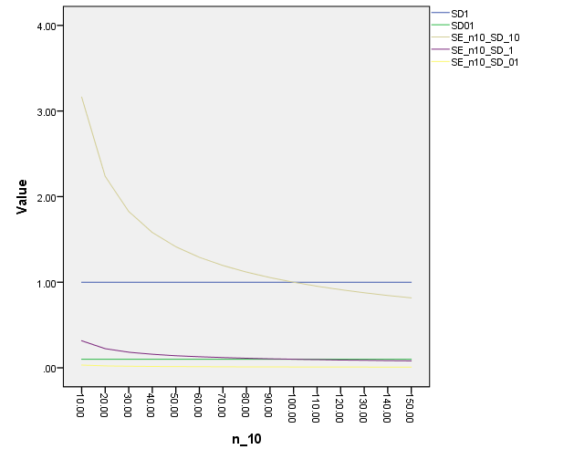
Mean standard error

Slide 9
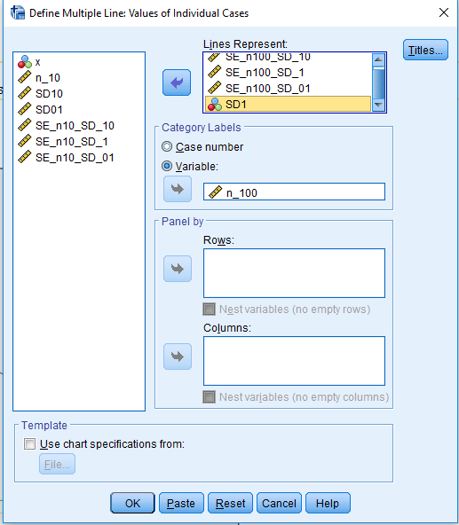
Mean standard error
Build a chart using the following instructions:
Graphs
Legacy Dialogue
Line…
Select: ‘Multiple’ and ‘Values of individual cases’
Lines Represent: All SE_n100 variables
SD1 and SD01
Category Labels: n_100

Slide 10
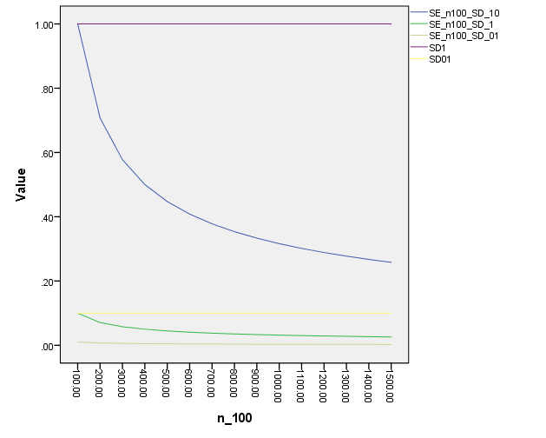
Mean standard error

Slide 11
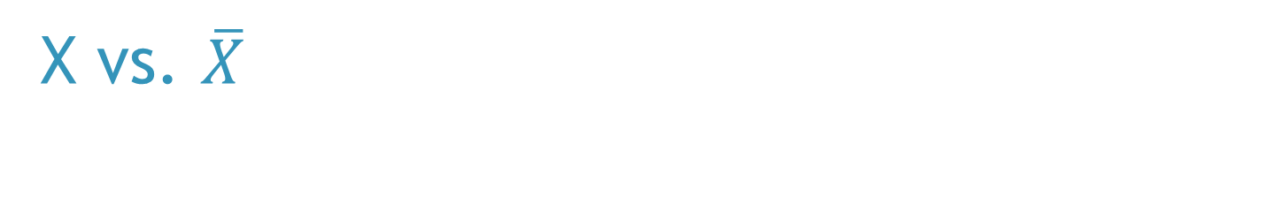
X vs. $\overline{X}$
Suppose we have systolic blood pressure data on 5,000 people
We have an ID variable, their S.BP and a dichotomous variable for high/low S.BP
What would the distributions look like for each variable?

Slide 12
X vs. $\overline{X}$
Suppose we have systolic blood pressure data on 5,000 people
We have an ID variable (1 to 5,000), their S.BP and a dichotomous variable for high/low S.BP
What would the distributions look like for each variable?
ID: Uniform
S.PB: Normal
High/low S.BP: Binomial

Slide 13
X vs. $\overline{X}$
Suppose we have systolic blood pressure data on 5,000 people
We have an ID variable (1 to 5,000), their S.BP and a dichotomous variable for high/low S.BP
Then, suppose we took 1,000 random samples of sizes 10, 50, 100, 500, and 1,000, found the mean for each sample, and compiled a dataset of those means
What would the distributions of the means look like?

Slide 14
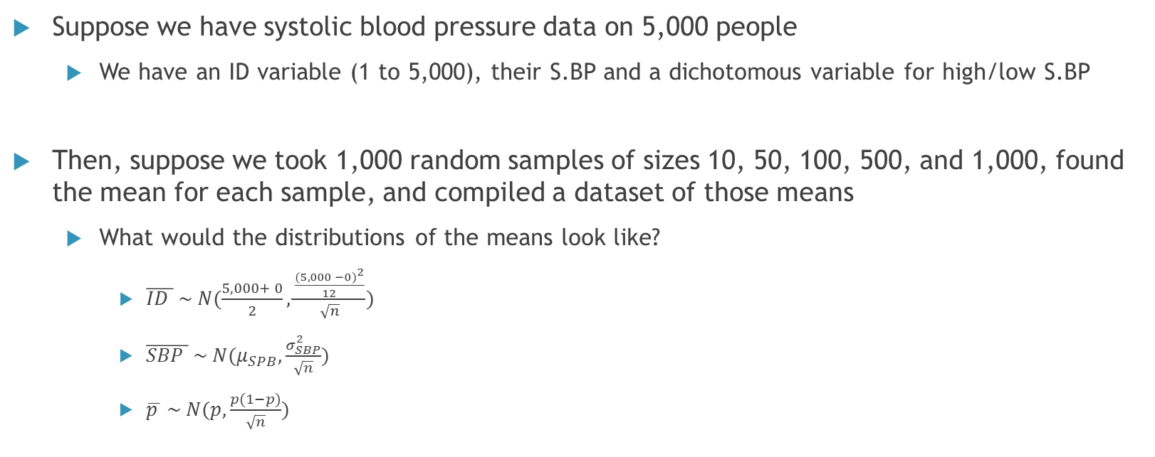
X vs. $\overline{X}$
Suppose we have systolic blood pressure data on 5,000 people
We have an ID variable (1 to 5,000), their S.BP and a dichotomous variable for high/low S.BP
Then, suppose we took 1,000 random samples of sizes 10, 50, 100, 500, and 1,000, found the mean for each sample, and compiled a dataset of those means
What would the distributions of the means look like?
$\overline{ID } \sim N(\frac{5,000+ 0}{2}, \frac{\frac{{(5,000 −0)}^{2}}{12}}{\sqrt{n}})$
$\overline{SBP } \sim N(μ_{SPB}, \frac{σ_{SBP}^{2}}{\sqrt{n}})$
$\overline{p } \sim N(p, \frac{p(1−p)}{\sqrt{n}})$

Slide 15
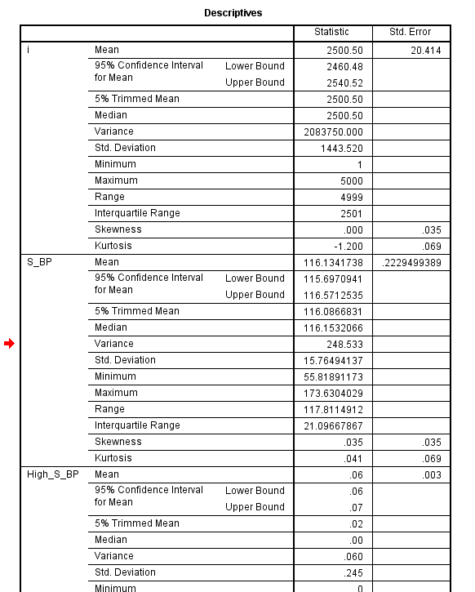
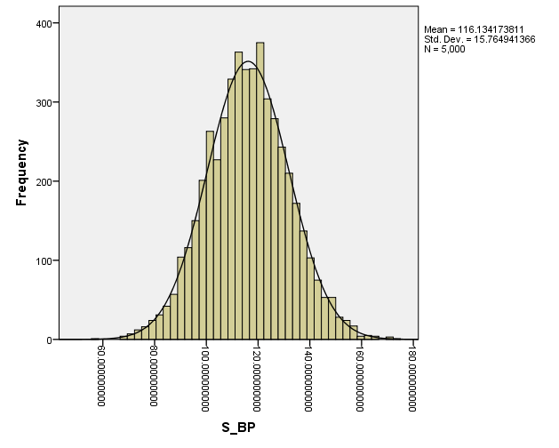
X vs. $\overline{X}$
Through explore, run descriptives and plots on each of the variables in the X_Dist dataset
Do the results reflect what you expected?
Means?
Standard Deviations?

Slide 16
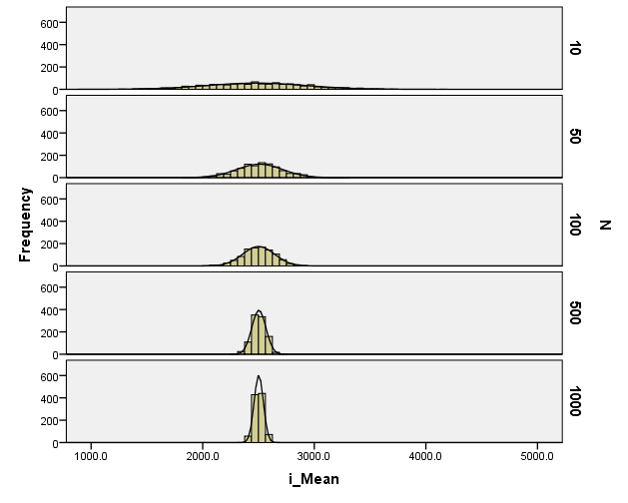
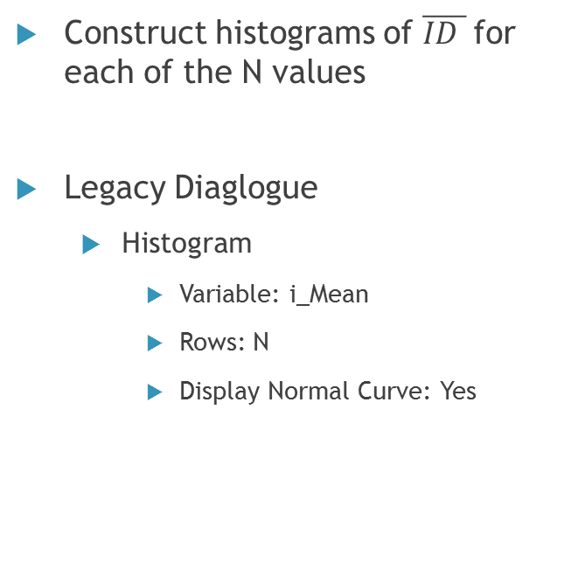
X vs. $\overline{X}$
Construct histograms of $\overline{ID }$for each of the N values
Legacy Diaglogue
Histogram
Variable: i_Mean
Rows: N
Display Normal Curve: Yes

Slide 17
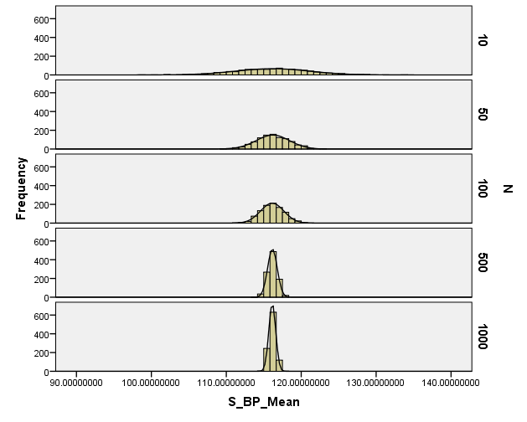
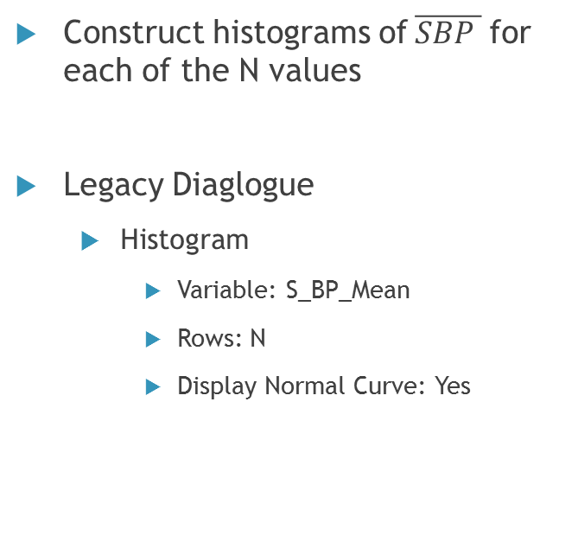
X vs. $\overline{X}$
Construct histograms of$\overline{SBP }$for each of the N values
Legacy Diaglogue
Histogram
Variable: S_BP_Mean
Rows: N
Display Normal Curve: Yes

Slide 18
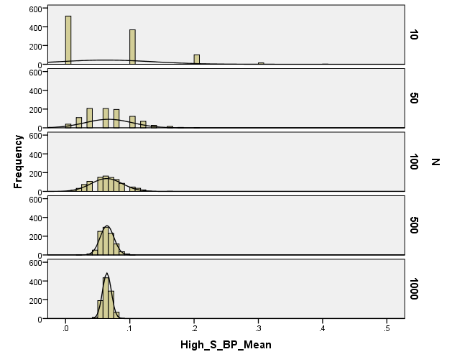
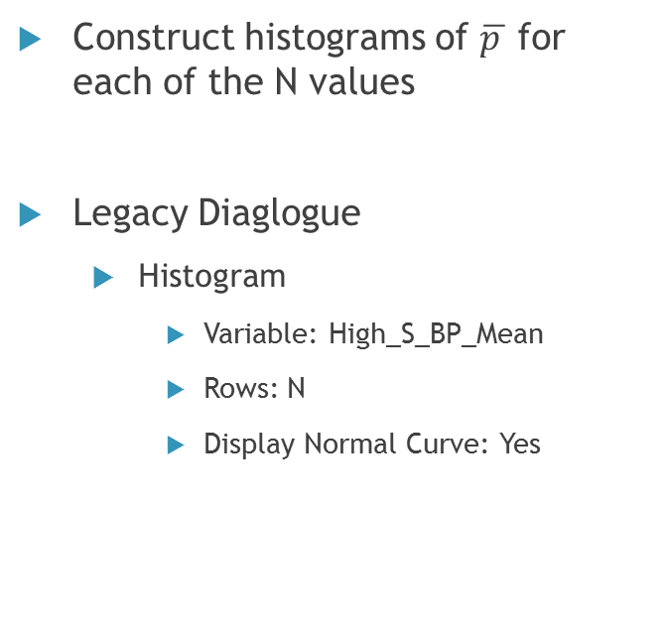
X vs. $\overline{X}$
Construct histograms of $\overline{p }$for each of the N values
Legacy Diaglogue
Histogram
Variable: High_S_BP_Mean
Rows: N
Display Normal Curve: Yes

